Slide 1
Pics or it didn’t happen

Slide 2
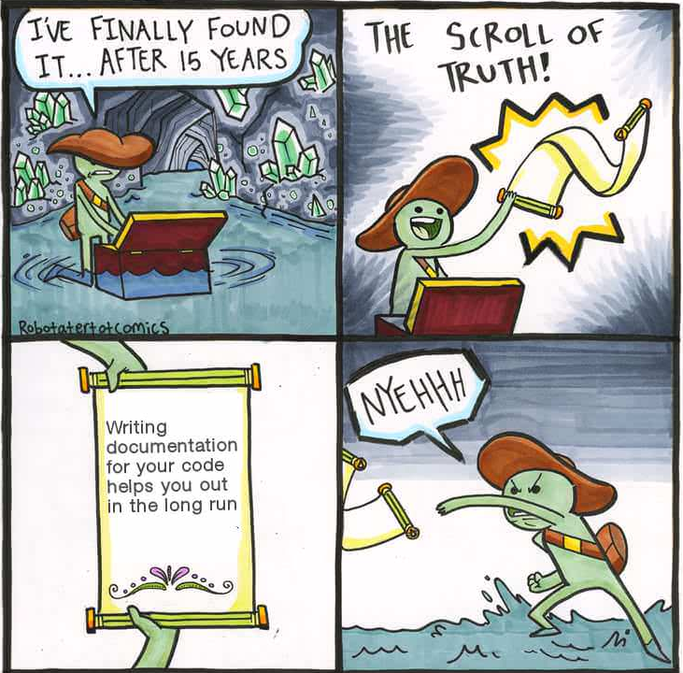

Slide 4
Hex: #8B4513
RGB: 139,69,19

Slide 5


Slide 6
White: #ffffff
Black: #000000
This means how many possible colors?

Slide 7
What do we want to do with images?
Seam Carving
Brightening
Black and white
Greyscale
Encode
Decode
Etc. etc.

Slide 8
How can we manipulate images?
Martin Osborne and Ken Lambert, wrote a package to help us with image manipulation
It is NOT a standard class
Helps us mostly load, manipulate and save images with ease

Slide 9
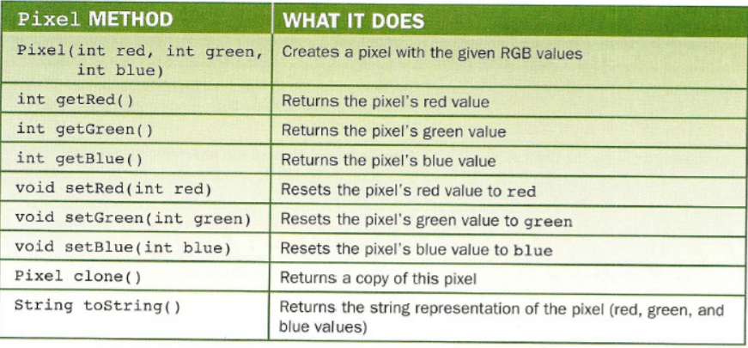
Pixel Class

Slide 10
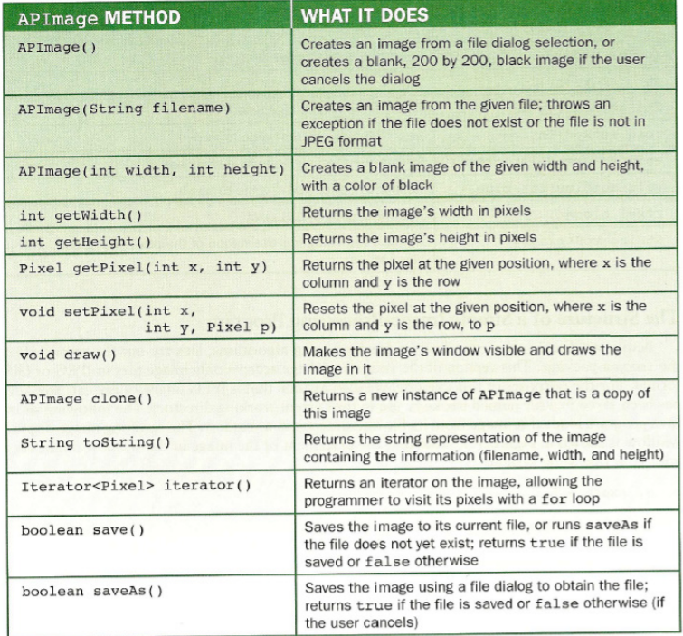
APImage Class

Slide 11
Mutators && Accessors
In other words: Getters and Setters

Slide 12
Mutators && Accessors
In other words: Getters and Setters
Getters
Setters

Slide 13
Constructors!
This is the “method” called to create the object.

Slide 14
Constructors!
This is the “method” called to create the object.
Constructor

Slide 15
toString()
APImage image = new APImage(“dog.png”);
System.out.print(image.toString());
Filename: dog.png
Width: 300 Height: 225

Slide 16
toString()
APImage image = new APImage(“dog.png”);
System.out.print(image.toString());
Same As:
System.out.print(image);

Slide 17
APImage
APImage is a 2DArray (Matrix) or Pixel Objects.

Slide 18
APImage

Slide 19
APImage
Pixel Object:
r= 00
g= 00
b= 00

Slide 20
APImage
How can we traverse the image?
For loops!

Slide 21
APImage
How can we traverse the image?
For loops!
for(int i = 0; i<image.getHeight(); i++){

Slide 22
APImage
How can we traverse the image?
For loops!
for(int i = 0; i<image.getHeight(); i++){
for( int j=0; j<image.getLength(); j++){

Slide 23
APImage

Slide 24
APImage
How can we traverse the image?
For loops!
for(Pixel p : image){

Slide 25
APImage

